Slide 1

Appium with Ruby
for Mobile Web Testing
Software Quality Assurance
Telerik Software Academy
http://academy.telerik.com

Slide 2

The Lectors
Atanas Georgiev
Senior QA Engineer
KendoUI Team

Slide 3
Real life issues
Not able to scroll, swipe, pinch (ChromeDriver): https://bugs.chromium.org/p/chromedriver/issues/detail?id=635
Not able to start tests in Windows (Appium): https://github.com/appium/appium/issues/5713

Slide 4
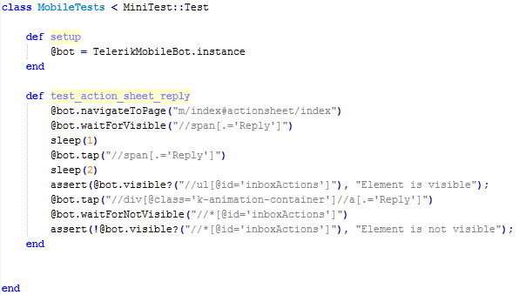
Sample test

Slide 5
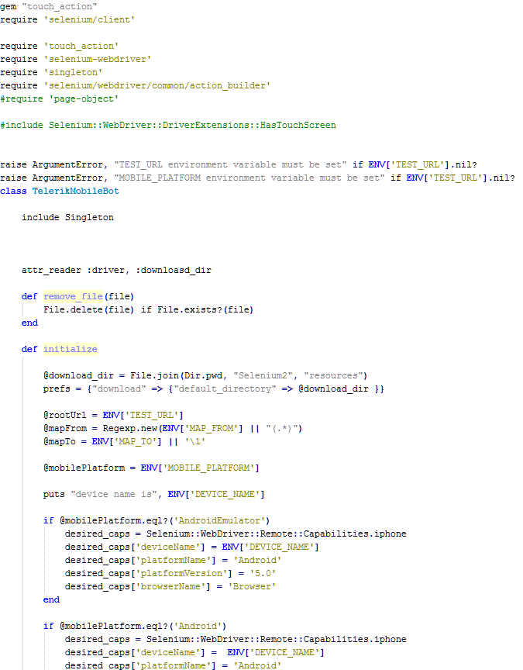
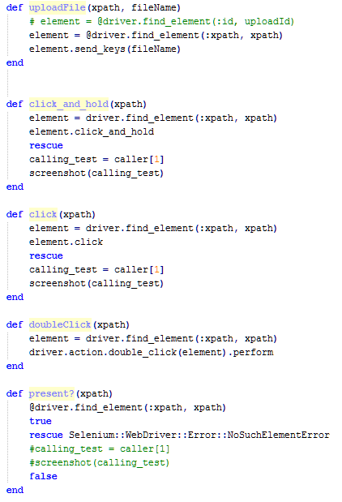
The “bot” file

Slide 6
Before we start
Start Appium
adb devices
List of devices attached
info: Welcome to Appium v1.4.13 (REV c75d8adcb66a75818a542fe1891a34260c21f76a)
info: Appium REST http interface listener started on 0.0.0.0:4723
info: Console LogLevel: debug
08dc6adc device

Slide 7
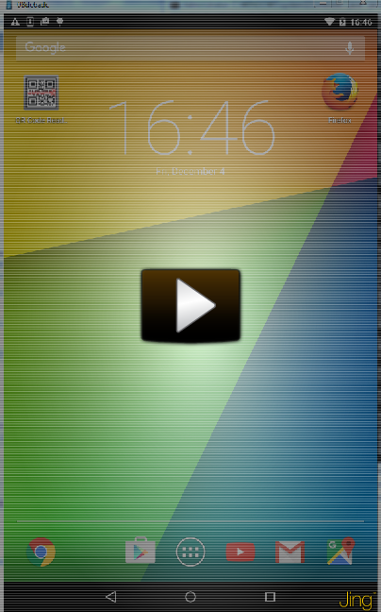
Run
MOBILE_PLATFORM="Android“
DEVICE_NAME="08dc6adc“
TEST_URL="http://kendobuild/staging-kendo-ui/"
MAP_FROM="web\/(.*)\.html“
MAP_TO='\1' ruby ActionSheet.rb
Run options: --seed 58933

Slide 8
Why not on Simulator?
No Chrome installed on Android simulators
Workarounds suggested here:
https://github.com/appium/appium/issues/1702

Slide 9
Tools Used
Droid@Screen
http://playingwithsid.blogspot.com/2012/03/how-to-display-your-android-screen-on.html
ASM
https://code.google.com/p/android-screen-monitor/
https://github.com/naskog/telerik-academy

Slide 10
Appium with Ruby
?
?
?
?
?
Questions?
?
?
?
?
?
?

Slide 11




Free Trainings @ Telerik Academy
C# Programming @ Telerik Academy
csharpfundamentals.telerik.com
Telerik Software Academy
academy.telerik.com
Telerik Academy @ Facebook
facebook.com/TelerikAcademy
Telerik Software Academy Forums
forums.academy.telerik.com

